Slide 1
Syntax Sentinels Team 2
An NLP-based code plagiarism detector

Slide 2
Presentation Roadmap
Meet the Team – Introduction to team members.
Existing Solutions: MOSS – Strengths and limitations.
Why It Matters – Importance of effective plagiarism detection.
Problem Statement – Challenges with current solutions and our motivation.
Demo – Live demonstration of the system.
Features – Overview of our NLP-based plagiarism detection system.
System Architecture – Technical breakdown of how our system works.
Model Design – The key components of our model
Q&A – Open floor for questions.
Notes:
Mohsin

Slide 3





Meet the Team
Mohammad
Mohsin
Khan
Dennis
Fong
Lucas
Chen
Luigi
Quattrociocchi
Julian
Cecchini
Notes:
Mohsin

Slide 4
Picture this!
Notes:
-You are a professor
-you give an assignments to your students
-later you suspect that there has been some cheating involved
- What tools can you use to confirm your suspicions

Slide 5

Existing Solution: MOSS (Measure of Software Similarity)
Strengths:
Effective for exact and near-exact code matches.
Widely used in academia and coding competitions.
Works across multiple programming languages.
Limitations:
Syntax-based approach – Cannot detect semantic plagiarism (e.g., logic-preserving transformations).
Struggles with function reordering, and code restructuring.
High false negatives – Clever modifications can evade detection.
Notes:
Mohsin

Slide 6

Why It Matters
Academic Integrity – Ensures fairness in grading and protects originality.
Code Competitions – Detects unfair advantages in submissions.
User Trust – Minimizes false positives/negatives for reliable detection.

Slide 7

Problem statement
Academic institutions, coding competition organizers, and online platforms need a more effective plagiarism detection system because current tools like MOSS rely on syntax-based comparisons. Our NLP-based solution detects semantic plagiarism, providing a more accurate, customizable, and scalable system.
Notes:
Mohsin

Slide 8
Demo
Notes:
Mohsin and Lucas

Slide 9
Features

Slide 10

Comprehensive Detection via an NLP approach
Semantic Understanding
Unlike traditional tools that rely on syntactic matching (such as MOSS), our system uses Natural Language Processing (NLP) to understand the semantic of the code.
Why is this better
This makes our product more effective at catching advanced plagiarism techniques like code obfuscation, inlining, block reordering and variable renaming.
All in all, this improves detection of logic-preserving plagiarism where code structure is changed but the functionality remains the same.
Notes:
Luigi

Slide 11
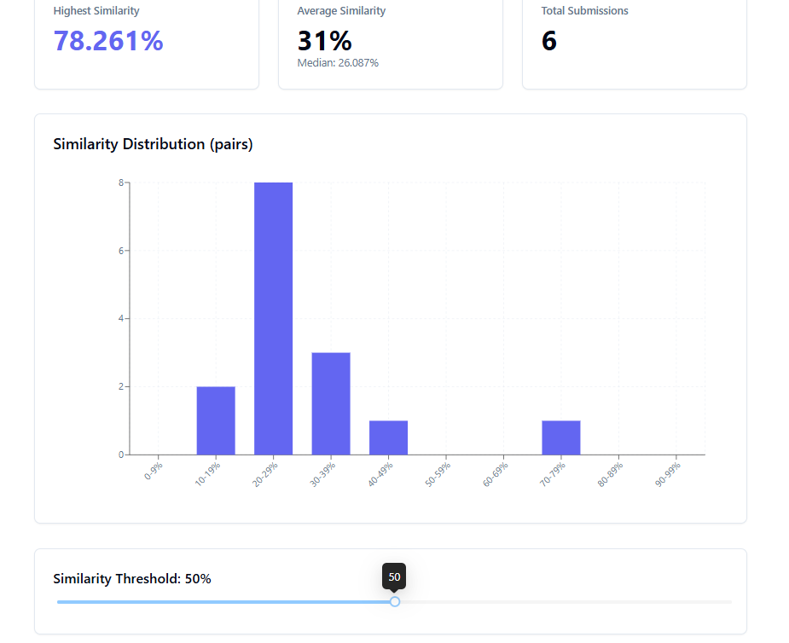
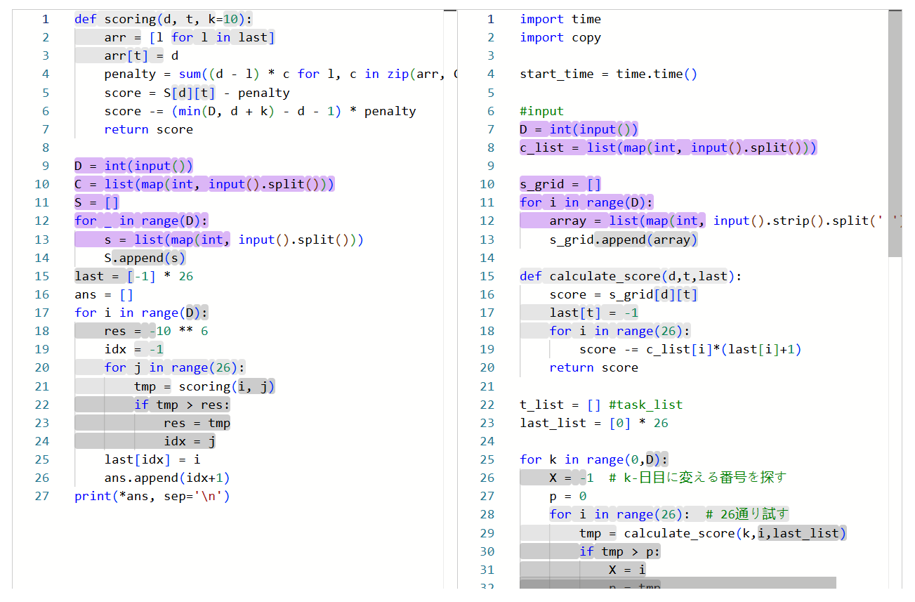
Detailed Reports
Provides comprehensive reports which includes:
Similarity scores as a histogram
Line by line analysis of file pairs
Helps users understand plagiarism insights clearly.
Notes:
Luigi

Slide 12
Why these features matter?
Streamlines the user experience of educators in maintaining academic integrity.
Visualizations provide a high-level overview of plagiarism within a corpus.
Improves precision and reduces false positives with NLP.
Notes:
Luigi

Slide 13

Changes to requirements documentation
Zero Data Retention (ZDR)
This was limiting from a user perspective.
Eliminating this requirement helped to streamline the user experience.
Emailing
The user flow for our revision 0 (receiving an email with your results) was not intuitive.
Instead of sending the results in a zip file, we have a button to download the results.
Notes:
Luigi

Slide 14
Architecture

Slide 15
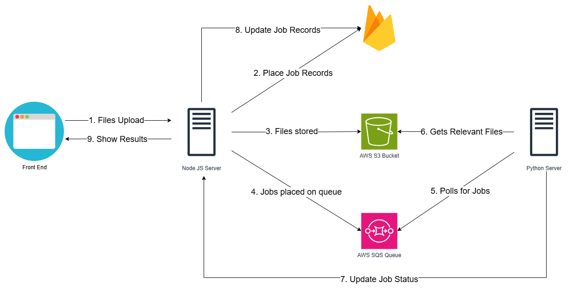
System Architecture
NLP
Notes:
lucas

Slide 16

Firebase - Firestore
What is Firestore?
Firestore is a NoSQL database
Firestore lives on the cloud, and is built on Google's infrastructure
Why Firestore?
We wanted to utilize a NoSQL database due to the unstructured nature of the data contained in a job
Real Time Sync – Connected clients receive updated data in real time
Other NoSQL databases such as DynamoDB or MongoDB require extra set up and cost to make this possible
No Management Required – Firestore is fully managed by Firebase. Scaling read/write capacities are done automatically
No need to manage read/write capacities (in DynamoDB), or manage clusters (in MongoDB)
Notes:
Dennis
We chose Firestore because we wanted a way to immediately notify the client of a job's status in real time

Slide 17

Simple Storage Service (S3)
What is S3?
Low cost, high-capacity object storage
Enables fast GET operation on objects
Why S3?
Zero cost for use cases this product was designed for
Can be scaled up to store much more data, while still costing almost nothing
To spend 1 cent, you'd need to upload 10,000 files approximately 43.5 KB each
Extremely Durable – objects in S3 are stored across multiple availability zones, meaning data can be recovered even through disaster
Highly Secure – Data is encrypted, and secured by permissions set by admins
Notes:
Dennis
We chose S3 because we needed a place to dump large amounts of code files for low cost

Slide 18

Simple Queue Service (SQS)
What is SQS?
SQS is a message queuing service
Allows decoupled applications to communicate with each other without interfering with each other
No more "Oh no, I broke the endpoint"
Why SQS?
NO cost – AWS allows you to send 1,000,000 requests in SQS every month, free of charge
Therefore, it is essentially FREE (unless you check for plagiarism more than 1,000,000 times a month)
Very Reliable – Provides "at least once" or "exactly once" delivery, ensuring messages are always received
No Management Required – SQS is fully managed by AWS. No need to worry about set up, or scalability. It is all done by AWS
Notes:
Dennis
Even if a server goes down, messages will still exist
We chose SQS because it can bridge our two servers together to hand off a job from the node server to the Python server

Slide 19
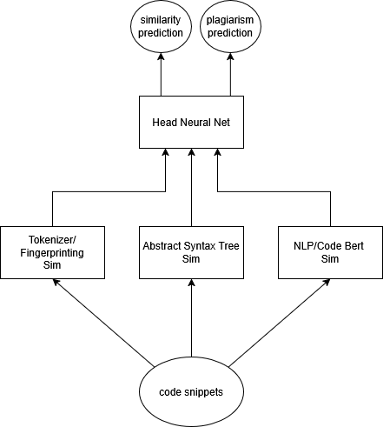
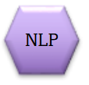
Model Design (Diagram)
Notes:
Dennis

Slide 20
Model Design (Diagram)
Key Components
Tokenization Sim Module (MOSS)
- AST Sim Module
NLP Module
Why include all?
Best of all worlds. Majority of the lifting is done by the NLP module, but additional pointers/clues that the NLP module may not catch can be provided by other similarity methods without significant computational overhead.
Results
Outperforms standard algorithm on cases where obvious signs of plagiarism are present.
Notes:
Dennis

Slide 21
What are the signs?
Token occurrence and frequency
Structure/ordering
Logical equivalences
Notes:
Luigi

Slide 22
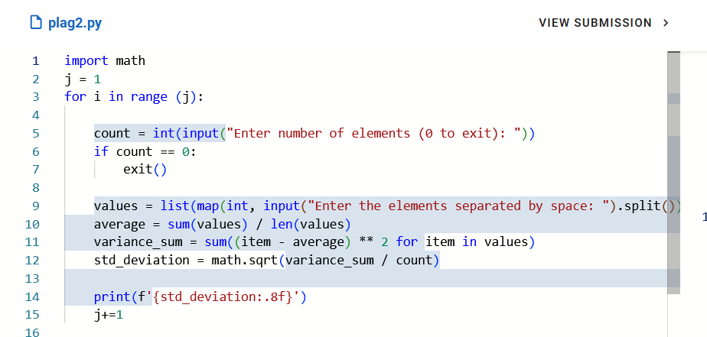
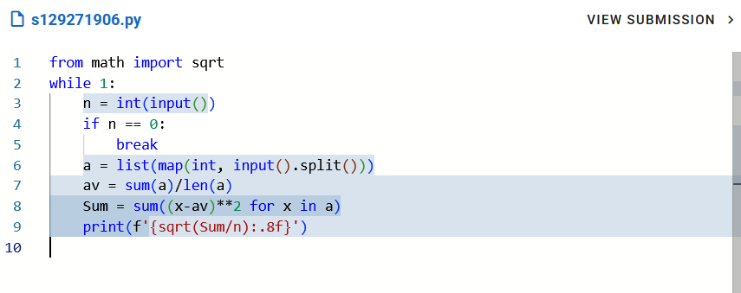
Example
Plagiarized file
Original file

Slide 23
What does MOSS say?
30% similarity with a batch mean of 64%
Above threshold of plagiarism provided by 7%
Overall, weak indication that plagiarism occurred
Notes:
Luigi

Slide 24
What does our model say?
Similarity of 68% with batch mean of 55%
Above threshold of plagiarism provided by 30%
Stronger indication that plagiarism has occurred
Notes:
Luigi

Slide 25
Thanks for listening!
Q&A

Slide 26
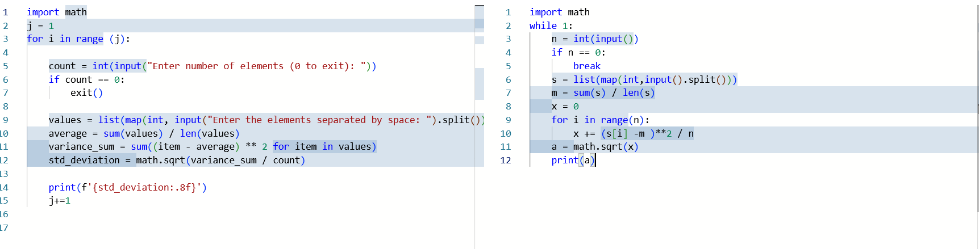
Another example from dataset

